Slide 1
Programming Logic, Flow Charts and Pseudocode

Slide 2
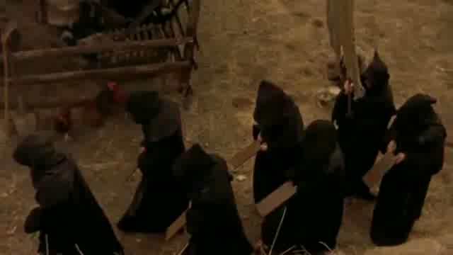
Programming Logic

Slide 3
Programming Logic
A program is a set of instructions for a computer.
A program can not have any arbitrary instructions
Three views of a program
Syntax
Semantics
Logic

Slide 4
Programming Logic
Syntax is the vocabulary used to write a program
Semantics is the meaning of an instruction when tokens (program vocabulary) are placed in a particular order
Logic is the specific order of the instructions

Slide 5
Programming Logic
Three types of programming errors
Compilation (Syntax) errors
Caused from syntax and/or semantic errors
Easiest errors to find because the program will not compile with these types of errors
Run-time errors
Caused when the program attempts to carry out and operation that is impossible to do
Invalid memory access, divide by zero
Sometimes difficult to find when intermittent

Slide 6
Programming Logic
Three types of programming errors
Logic error
Error caused by incorrect sequence of statements
Most difficult error to find because the program will continue to run but produce incorrect results
Most commonly due to an incorrect boolean expressions

Slide 7
Programming Logic
Logic: Instructions given to the computer in a specific sequence, without omitting any instructions or adding extraneous
Logic error: An error that occurs when incorrect instructions are performed, or when instructions are performed in the wrong order.

Slide 8
Programming Logic
What do you call a bug (program error) that can not be eliminated?
A feature

Slide 9
Programming Logic
Execution Flow Paths
Sequential
A B C
Selection
A B C
D
Repeating
A B C D

Slide 10
Programming Logic
Programming Logic Constructs
All structured programs can be written using only three constructions: sequential, selection, and repeating
Each construction has a single entry point and a single exit point
Construction combinations
Stacked
Nested

Slide 11
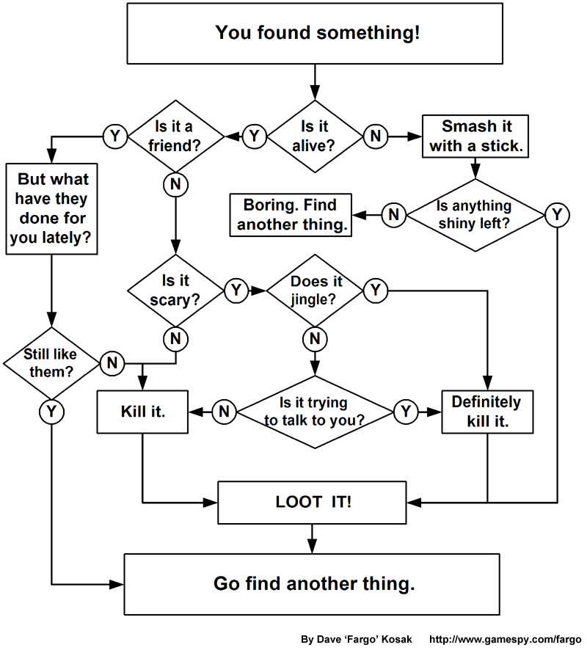
Flowcharts

Slide 12
Flowcharts
A flowchart is a method to symbolically represent execution flow paths.
Flowcharts can be used to design the logic of a program before actual coding takes place.
Major parts of a flow chart: terminals, input/output operations, processes, connectors, decision, external module

Slide 13
Flowcharts
Terminal
Begins and ends the programming flow
Does not necessarily represent any code
Connectors
On page connector
Off page connector

Slide 14
Flowcharts
Processes
Represents all statements that are not specifically represented by other symbols
Could be one statement or several statements depending on the level of abstraction (see later slides)
All constructs can be represented by a process rectangle

Slide 15
Flowcharts
Input/Output operations
Represents input from the user (keyboard, mouse)
Represents output to the user (monitor, printer)
Type of operation should be clear from context or labeled on symbol
This is really just a special process rectangle

Slide 16
Flowcharts
External Module
Represents a collection of instruction that is outside of the flowchart
Flow goes into and out of the external module but what happens inside the module is of no concern as long as the module does what it advertises
An external module can be expanded into it’s own flowchart

Slide 17
Flowcharts
Decision
This is the work horse of the flowchart
Can represent a yes/no decision or a multi-answer decision
Used to build selection and repeating constructs

Slide 18
Flowcharts
Start
Sequential
Almost all programs can be represented with the flowchart on the left
READ input, Calculate, WRITE output
“Do Something” is replaced by other constructs
Replacement can be done through top-down stepwise refinement
Get Input
Do Something
Write Output
End

Slide 19
Flowcharts
Sequence with connectors
A
Start
Do Something
Do more stuff
Get Input from User
Send Output to User
Do Something else
A
End

Slide 20
Flowchart
Simple Selection

Slide 21
Flowcharts
Multi-way selection (case structure)

Slide 22
Flowcharts
Repetition with Pre-test loop
Test
Statements in Loop
Statements after loop

Slide 23
Flowcharts
Repetition with Post-test loop
Statements inside the loop
Test
Statements after the loop

Slide 24
Flowcharts
Rules for forming structured programs using flowcharts
Begin with the simplest flowchart
Any rectangle (action) can be replaced by two rectangles (actions) in sequence
Any rectangle (action) can be replaced by any control statement (selection or repetition)
Rules 2 and 3 can be applied as often as needed and in any order

Slide 25
Abstraction
Abstraction is the process of removing nonessential details from an object
Abstraction lets us pay attention to only what is needed at the moment
Abstraction is seen in the use of the process symbol in flowcharts
Process could be one programming statement
It could be several statements
It could be an entire other flowchart

Slide 26
Flowcharts - Example
Write a program that will allow the user to enter grades until the user enters a -1. The program should then average the grades and then display the average.
Start
Average an undetermined number of grades
End

Slide 27
Flowchart - Example
Start
Get grades from user
Calculate Average
Display Average
End

Slide 28
Flowchart - Example
Start
Get first grade from user
Is grade not -1
Add grade to totalGrade
Add 1 to count
Get next grade from user
Yes
No
Calculate Average
Display Average
End

Slide 29
Flowchart - Example
Start
Set totalGrade = 0
Set count = 0
Get first grade from user
Is grade not -1
Add grade to totalGrade
Add 1 to count
Get next grade from user
Yes
No
No
Is count > 0
Yes
Set average = totalGrade / count
Display “No Grades to Average”
Display Average
End

Slide 30
Pseudo-code
A kind of structured English for describing algorithms
Focuses on logic instead of syntax
Must be complete as it describes the entire logic of the algorithm
Should be implementation neutral

Slide 31
Pseudo-code
The Structure Theorem
It is possible to write any computer program by using only three basic control structures: sequence, selection, and repetition
Pseudo-code follows the structure theorem
Any properly formed flowchart can be written as pseudo-code and vice-versa

Slide 32
Pseudo-code
Rules
One statement per line
Only include statements that perform some action
Receive information
Output information
Perform a calculation (arithmetic)
Assign a value
Compare two values
Repeat
Capitalize initial keywords

Slide 33
Pseudo-code
Rules
Indent to show hierarchy
Sequence: keep statements that are “stacked” in a sequence all starting in the same column
Selection: indent that statements that fall inside the selection structure, but not the keyword that form the selection
Repetition: indent the statements that fall inside the loop, but not the keywords that form the loop
End multiline structures

Slide 34
Pseudo-code
Keywords
Sequence
READ, WRITE, SET =, CALL
Calculation symbols: *, /, +, -, ^, %, ()
Selection
IF THEN, ELSE, ENDIF
CASE OF, ENDCASE
Relational operators
<, <=, >, >=, ==, <>
Logical operators
AND, OR, NOT

Slide 35
Pseudo-code
Keywords
Repetition
WHILE, ENDWHILE
REPEAT, UNTIL
FOR start TO end STEP increment, ENDFOR
FOREACH item IN set, ENDFOREACH

Slide 36
Pseudo-code
Keywords
Program
PROGRAM programName, ENDPROGRAM
Functions
FUNCTION functionName : parameterList, ENDFUNCTION
RETURN

Slide 37
Pseudo-code
Storing data
Data is stored in variables
Naming variables
variable names will start with a lowercase letter
they will have no spaces in them
additional words in them will start with a capital
names must be unique within the program

Slide 38
Pseudo-code Example
Write a program that will allow the user to enter grades until the user enters a -1. The program should then average the grades and then display the average.
Average a list of numbers and display average

Slide 39
Pseudo-code Example
Get numbers from user
Calculate the average
Display the average

Slide 40
Pseudo-code Example
SET count = 0
SET totalGrade = 0
READ grade
WHILE grade <> -1
SET totalGrade = totalGrade + grade
SET count = count + 1
READ grade
ENDWHILE
Calculate the average
Display the average

Slide 41
Pseudo-code Example
SET count = 0
SET totalGrade = 0
READ grade
WHILE grade <> -1
SET totalGrade = totalGrade + grade
SET count = count + 1
READ grade
ENDWHILE
IF count > 0 THEN
SET average = totalGrade / count
WRITE average
ELSE
WRITE “No grades to average”
ENDIF

